Slide 1
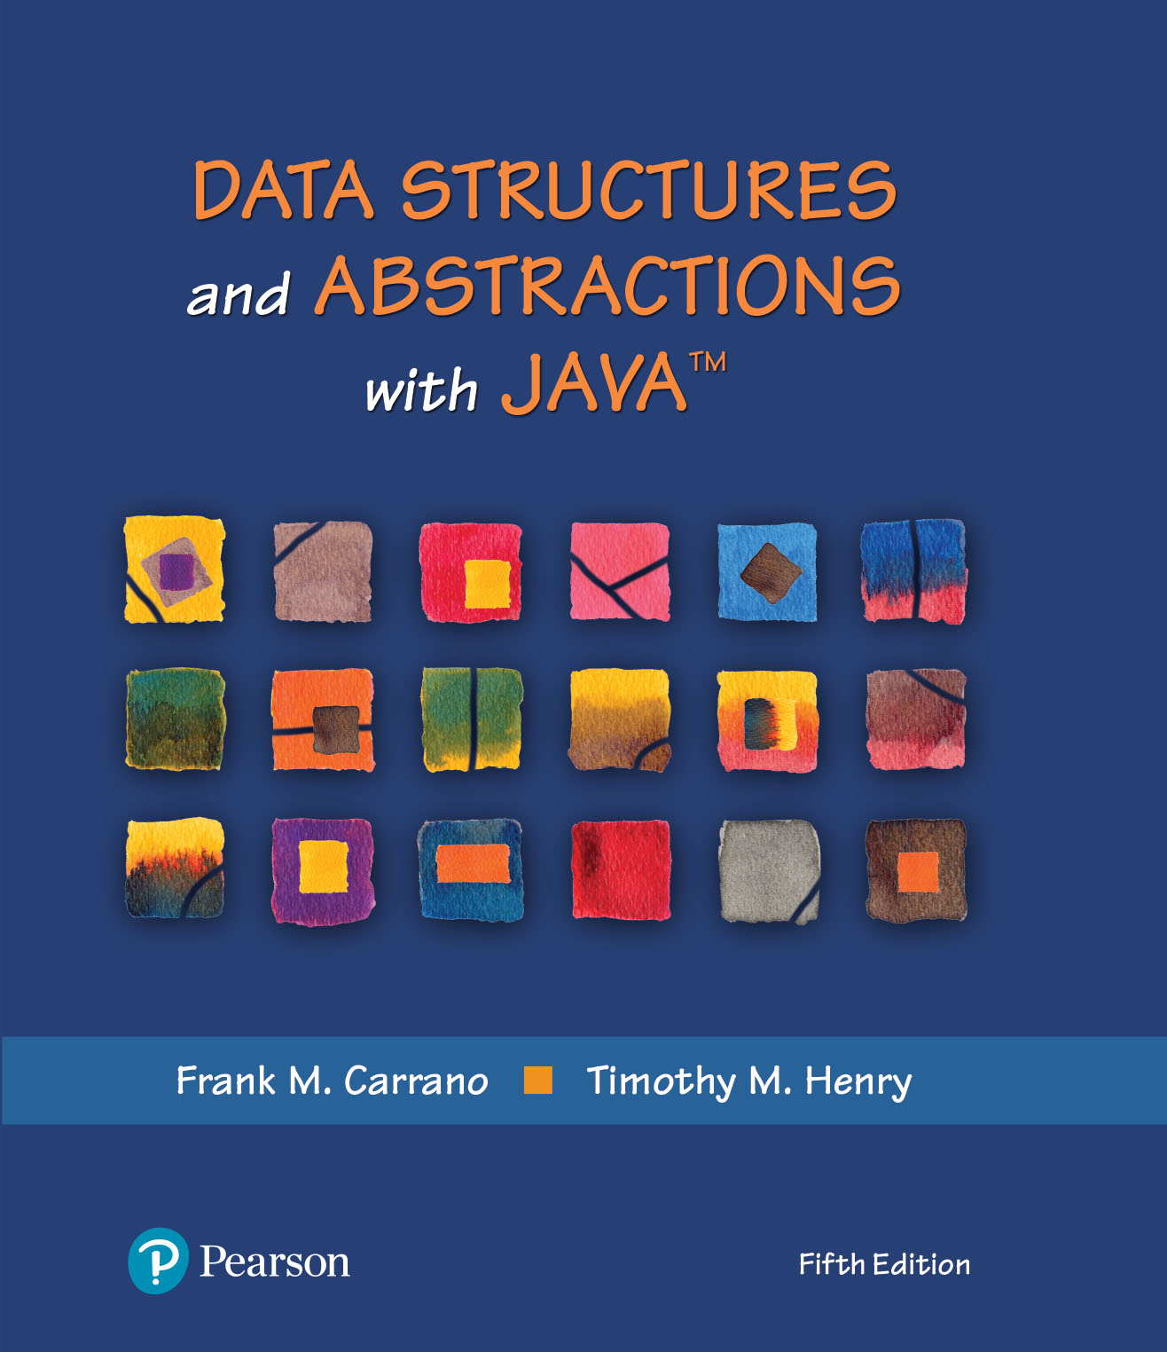
Module 7
Stacks & Stack Implementation

Slide 2
Video Notes
The ADT Stack
https://mediaplayer.pearsoncmg.com/assets/secs-vn-ch05a-the-adt-stack
Using the ADT Stack
https://mediaplayer.pearsoncmg.com/assets/secs-vn-ch04a-measuring-efficiency
Class LinkedStack
https://mediaplayer.pearsoncmg.com/assets/secs-vn-ch06a-the-class-linked-stack
Class ArrayStack
https://mediaplayer.pearsoncmg.com/assets/secs-vn-ch06b-the-class-array-stack
Notes:
To maximize your learning experience, watch videos prior to attending class each week
We will look at two implementations, array based and linked, for each ADT

Slide 3
Additional Videos
Infix to Postfix conversions example
https://www.youtube.com/watch?v=MxKBRgyO-94&ab_channel=Education4u
Data Structures | Introduction | Lec-1 | Bhanu Priya
https://www.youtube.com/watch?v=coxWfcz_sIk&list=PLrjkTql3jnm8ikiQIeIHrMYCaBfkBkfYR
https://www.youtube.com/watch?v=coxWfcz_sIk&list=RDCMUCKS34cSMNaXaySe2xgXH-3A&start_radio=1&t=162
Notes:
To maximize your learning experience, watch videos prior to attending class each week
We will look at two implementations, array based and linked, for each ADT

Slide 4
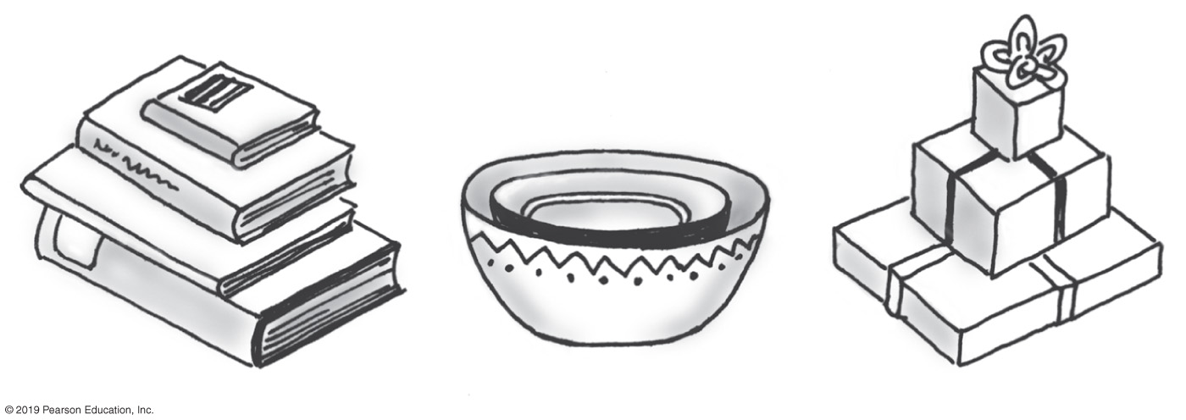
Stacks | Definition
Add item on top of stack
Remove item that is topmost
Last In, First Out … LIFO
Notes:
A stack is a data structure

Slide 5
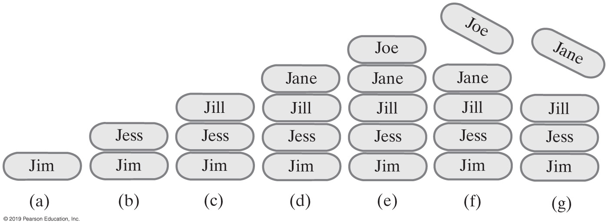
Stack Example
StackInterface<String> stringStack = new OurStack<>();
(a) stringStack.push(“Jim”);
(b) stringStack.push("Jess");
(c) stringStack.push("Jill");
(d) stringStack.push("Jane");
(e) stringStack.push("Joe");
(f) stringStack.pop();
(g) stringStack.pop();
Notes:
For (b), we cannot remove Jim until we have removed Jess (first)
Stack is practical; used by many application

Slide 6
ADT Stack | Operations
Pseudocode | UML | Description
push(newEntry) | +push(newEntry: T): void | Task: Adds a new entry to the top of the stack. Input: newEntry is the new entry. Output: None.
pop() | +pop(): T | Task: Removes and returns the stack’s top entry. Input: None. Output: Returns the stack’s top entry. Throws an exception if the stack is empty before the operation.
peek() | +peek(): T | Task: Retrieves the stack’s top entry without changing the stack in any way. Input: None. Output: Returns the stack’s top entry. Throws an exception if the stack is empty.
isEmpty() | +isEmpty(): boolean | Task: Detects whether the stack is empty. Input: None. Output: Returns true if the stack is empty.
clear() | +clear(): void | Task: Removes all entries from the stack. Input: None. Output: None.
Notes:
push and pop are the basic (critical) operations of a stack

Slide 7
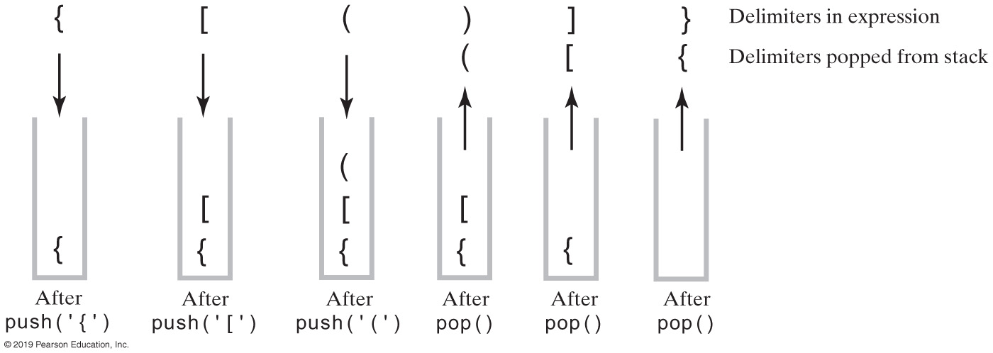
Example | Balanced Delimiters
The contents of a stack during the scan of an expression that contains balanced delimiters{ [ ( ) ] }
Notes:
Watch video
This is how your IDE checks for syntax error
Activity 3.1

Slide 8
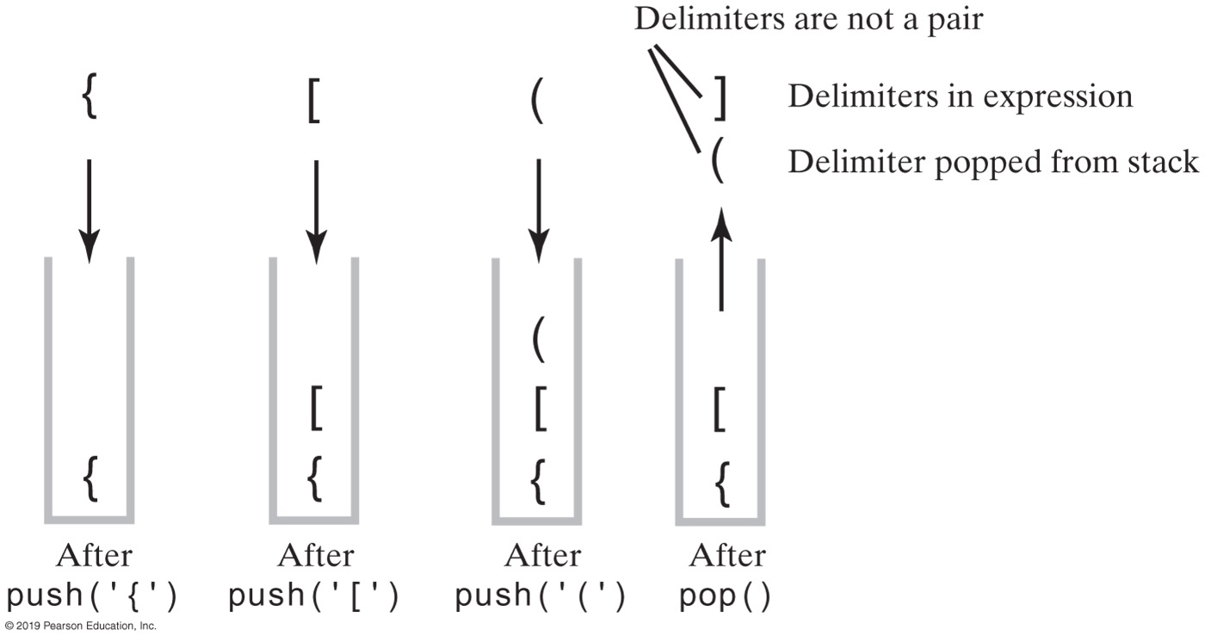
Expression | Unbalanced Delimiters
The contents of a stack during the scan of an expression that contains unbalanced delimiters { [ ( ] ) }

Slide 9
Processing Algebraic Expressions
Algorithm checkBalance(expression)
// Returns true if the parentheses, brackets, and braces in an expression are paired correctly.
isBalanced = true // The absence of delimiters is balanced
while ((isBalanced == true) and not at end of expression)
{
nextCharacter = next character in expression
switch (nextCharacter)
{
case '(': case '[': case '{':
Push nextCharacter onto stack
break
case ')': case ']': case '}':
if (stack is empty)
isBalanced = false
else
{
openDelimiter = top entry of stack
Pop stack
isBalanced = true or false according to whether openDelimiter and nextCharacter are a pair of delimiters
}
break
}
}
if (stack is not empty)
isBalanced = false
return isBalanced

Slide 10
Algebraic Expressions
Infix :
each binary operator appears between its operands a + b
Postfix:
each binary operator appears after its operands a b +
Prefix:
each binary operator appears before its operands + a b
We need to write code to process
a / b * (c + (d - e))
Notes:
a = 2, b = 4, a + b = ?
What’s the easiest way for a computer to process the above expression?
Infix vs. Postfix

Slide 11
Infix-to-postfix Conversion (Rule)
To convert an infix expression to postfix form, you take the following actions, according to the symbols you encounter, as you process the infix expression from left to right:
Operand | Append each operand to the end of the output expression.
Operator ^ | Push ^ onto the stack.
Operator +, -, *, or / | Pop operators from the stack, appending them to the output expression, until either the stack is empty or its top entry has a lower precedence than the newly encountered operator. Then push the new operator onto the stack.
Open parenthesis | Push ( onto the stack.
Close parenthesis | Pop operators from the stack and append them to the output expression until an open parenthesis is popped. Discard both parentheses.
Notes:
Operands: a, b
Operator: +

Slide 12
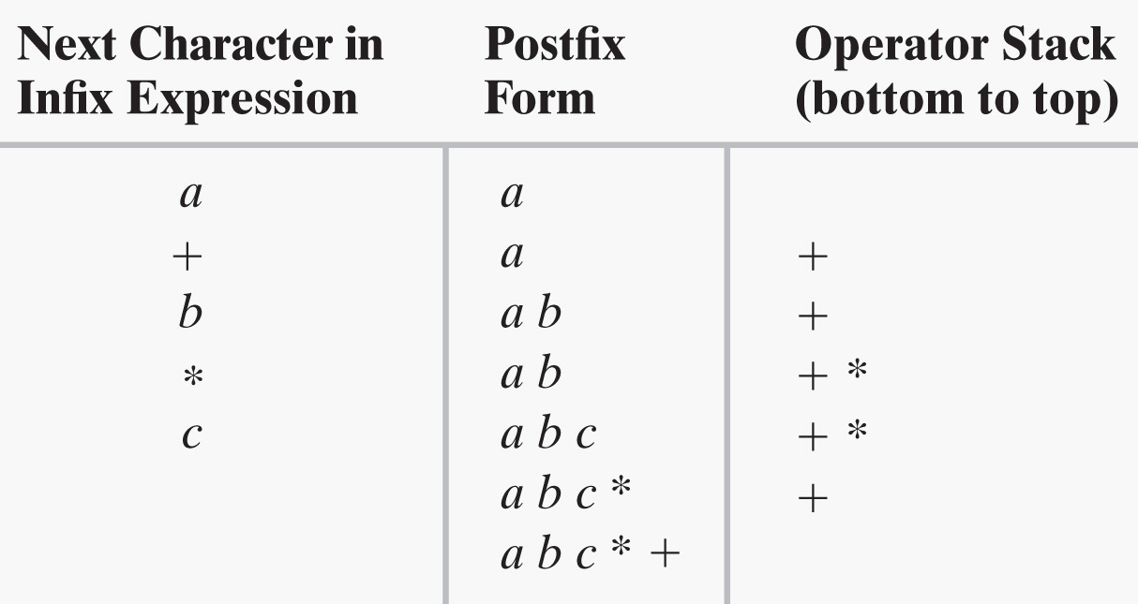
Converting Infix to Postfix (1 of 2)
a + b * c
What about ? a - b + c
Notes:
Stack contains operators
Build your postfix expression “on the fly”

Slide 13
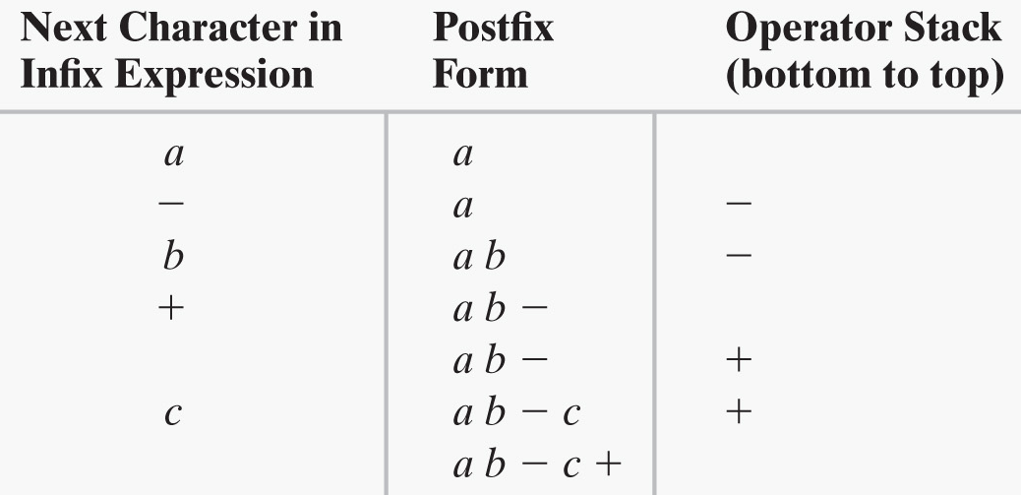
Converting Infix to Postfix (2 of 2)
a - b + c

Slide 14
Activity: Examples
A + B * C + D
(A + B) * (C + D)
A * B + C * D
A + B + C + D
x ^ y / (5 * z) + 10
Infix / Postfix Converter
https://www.mathblog.dk/tools/infix-postfix-converter/
Infix, Prefix and Postfix Expressions
http://interactivepython.org/runestone/static/pythonds/BasicDS/InfixPrefixandPostfixExpressions.html
Be able to do this by hand

Slide 15
Solutions | Previous Examples
Infix | Postfix
A + B * C + D | A B C * + D +
(A + B) * (C + D) | A B + C D + *
A * B + C * D | A B * C D * +
A + B + C + D
What about?
a / b * (c + (d - e))
Notes:
Notice the postfix expressions

Slide 16
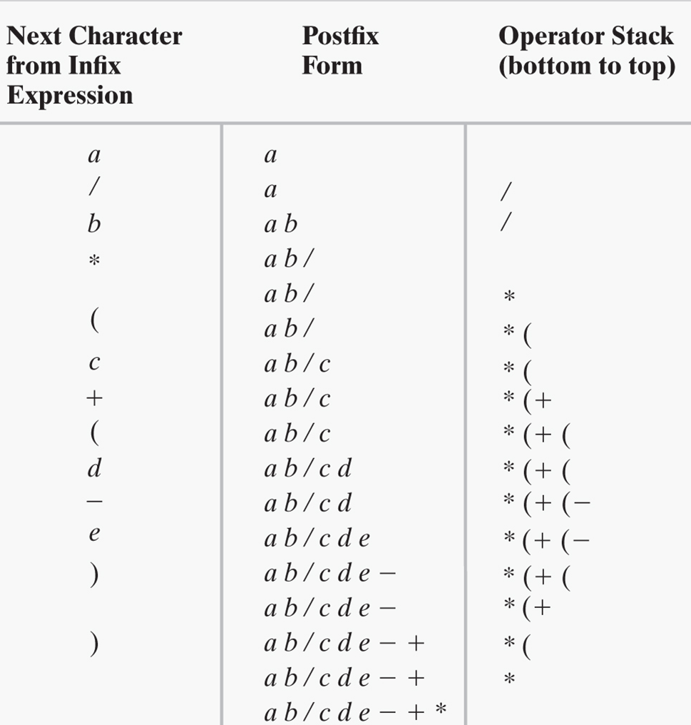
Exercise | Take Home
a / b * (c + (d - e))

Slide 17
Infix-to-postfix Algorithm (1 of 2)
Algorithm convertToPostfix(infix)
// Converts an infix expression to an equivalent postfix expression.
operatorStack = a new empty stack
postfix = a new empty string
while (infix has characters left to parse)
{
nextCharacter = next nonblank character of infix
switch (nextCharacter)
{
case variable:
Append nextCharacter to postfix
break
case '^' :
operatorStack.push(nextCharacter)
break
case '+' : case '-' : case '*' : case '/' :
while (!operatorStack.isEmpty() and
precedence of nextCharacter <= precedence of operatorStack.peek())
{
Append operatorStack.peek() to postfix
operatorStack.pop()
}
operatorStack.push(nextCharacter)
break

Slide 18
Infix-to-postfix Algorithm (2 of 2)
case '( ' :
operatorStack.push(nextCharacter)
break
case ')' : // Stack is not empty if infix expression is valid
topOperator = operatorStack.pop()
while (topOperator != '(')
{
Append topOperator to postfix
topOperator = operatorStack.pop()
}
break
default:
break // Ignore unexpected characters
}
}
while (!operatorStack.isEmpty())
{
topOperator = operatorStack.pop()
Append topOperator to postfix
}
return postfix

Slide 19
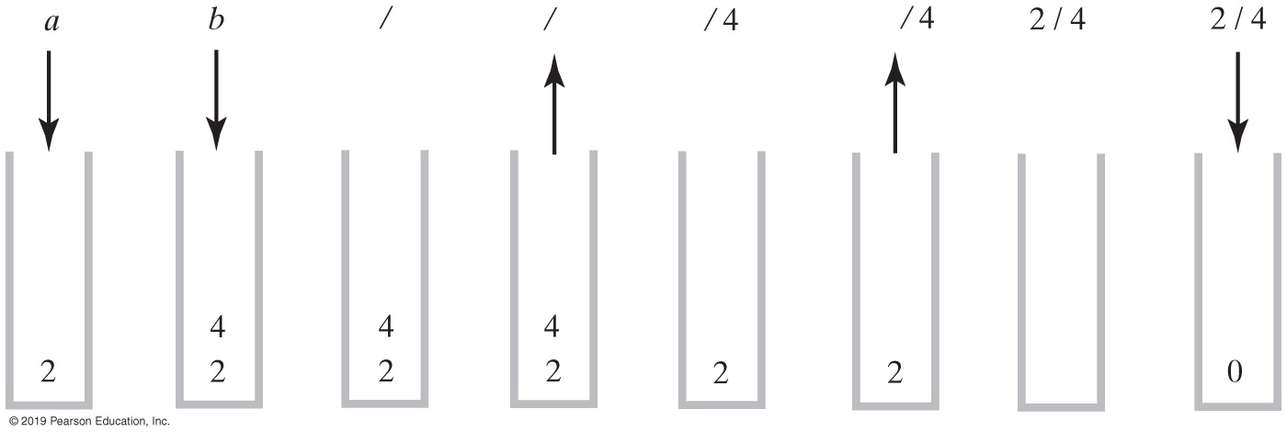
Expression | Postfix Evaluation
Evaluation of the postfix expression a b / where a is 2 and b is 4
Notes:
Notice how we pop operands: (1) to the right of the operator, then (2) to the left

Slide 20
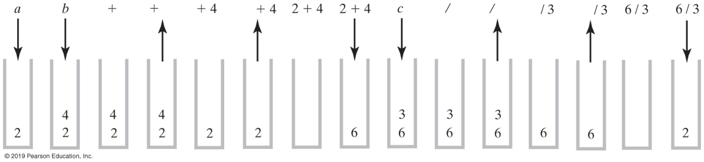
Postfix Evaluation
Evaluation of the postfix expression a b + c / where a = 2, b = 4, c = 3

Slide 21
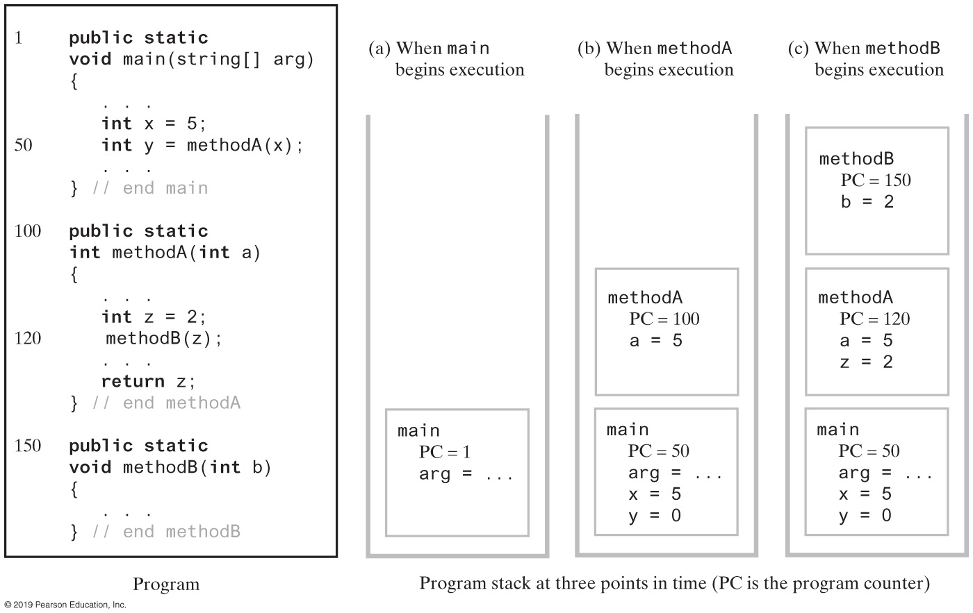
Application Program Stack
Notes:
Characteristics of function calls

Slide 22
Class Stack(Java Class Library)
Available in java.util
Methods
A constructor – creates an empty stack
public T push(T item);
public T pop();
public T peek();
public boolean empty();
Java’s API Stack class is a generic stack structure
We are learning what a Stack is and how to use it
Notes:
The Stack is readily available

Slide 23
Stack & Queue | Restricted Structures
Two most commonly used restricted structures
Restricting basic operations & access modes of standard ADT
Ideally suited for a good number of applications
Operation restrictions
Update is not supported
Insert is supported (but restricted)
Fetch and Delete are combined into one operation
Arithmetic vs. ADT operations
23
Notes:
insert, delete, update, get

Slide 24
Restrictions (Restricted Structures)
Access mode restrictions
Key field mode is not supported
Node number mode is severely restricted
Restrictions on Node Number Access Mode
Can’t say “Fetch-and-Delete the 3rd node”
Can only say “Fetch-and-Delete”
For a Queue: the node returned and deleted is the node in the structure the longest time
For a Stack: the node returned and deleted is the node in the structure the shortest time
A priority queue is a restricted structure used in scheduling applications
24
Notes:
We will learn how to implement a priority queue later

Slide 25
ADT Stack | Interface
/** An interface for the ADT stack. */
public interface StackInterface<T>
{
/** Adds a new entry to the top of this stack.
@param newEntry An object to be added to the stack. */
public void push(T newEntry);
/** Removes and returns this stack's top entry.
@return The object at the top of the stack.
@throws EmptyStackException if the stack is empty before the operation. */
public T pop();
/** Retrieves this stack's top entry.
@return The object at the top of the stack.
@throws EmptyStackException if the stack is empty. */
public T peek();
/** Detects whether this stack is empty.
@return True if the stack is empty. */
public boolean isEmpty();
/** Removes all entries from this stack. */
public void clear();
} // end StackInterface

Slide 26
Module 7B
Implementations

Slide 27
Design Decision
When stack is full
When stack is empty
What to do with pop and peek?
Possible actions
Assume that the ADT is not empty
Return null (why null?)
Throw user defined exception, EmptyStackException
Prefer throwing exceptions instead of returning values to signal problem
Avoid ambiguous return values

Slide 28
Linked Implementation
Each operation involves top of stack
push
pop
peek
Head of linked list easiest, fastest to access
Let this be the top of the stack

Slide 29
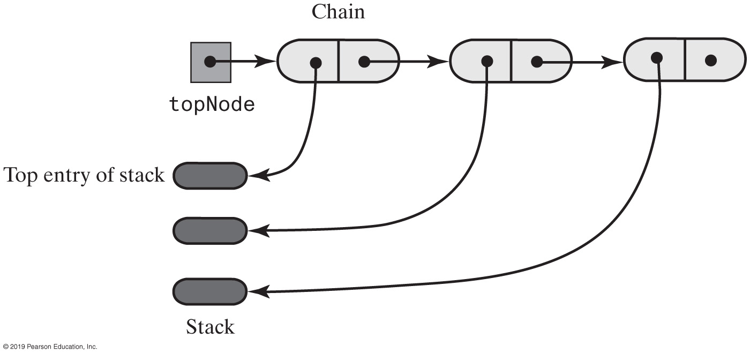
Linked Implementation
A chain of linked nodes that implements a stack

Slide 30
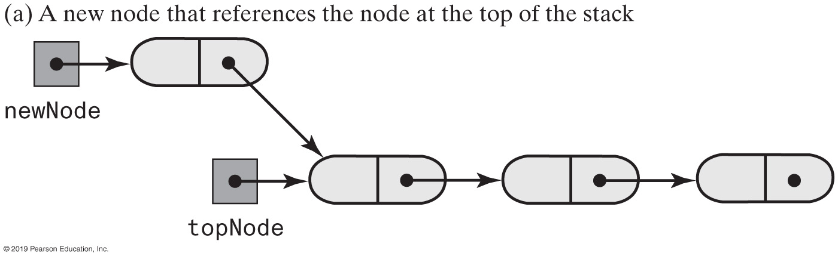
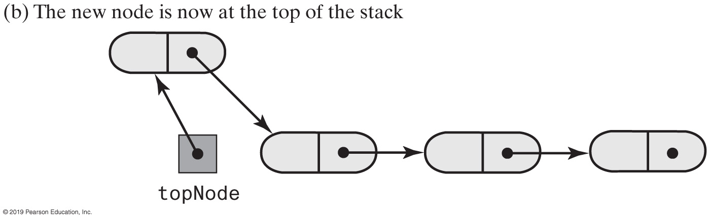
Stack | Push
Notes:
We know how to do this; just like adding a new node to a linked chain

Slide 31
Stack | Linked Implementation
/** A class of stacks whose entries are stored in a chain of nodes. */
public final class LinkedStack<T> implements StackInterface<T>
{
private Node topNode; // References the first node in the chain
public LinkedStack()
{
topNode = null;
} // end default constructor
// < Implementations of the stack operations go here. >
// . . .
private class Node
{
private T data; // Entry in stack
private Node next; // Link to next node
// < Implementations of the node operations go here. >
} // end Node
} // end LinkedStack

Slide 32
Stack | Linked Implementation
public void push(T newEntry)
{
Node newNode = new Node(newEntry, topNode);
topNode = newNode;
} // end push

Slide 33
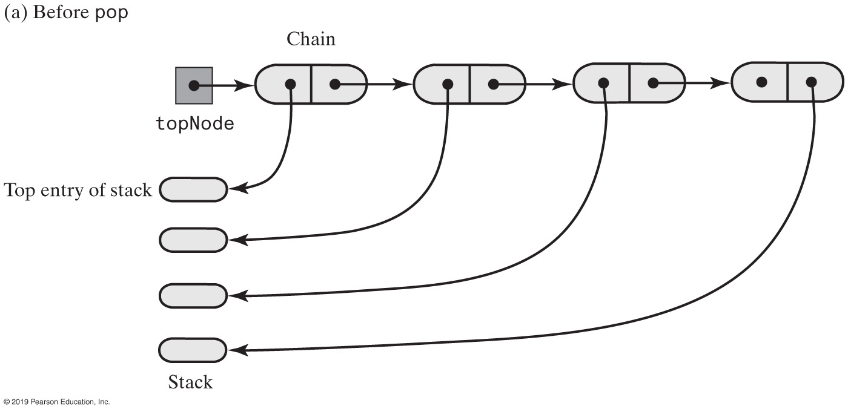
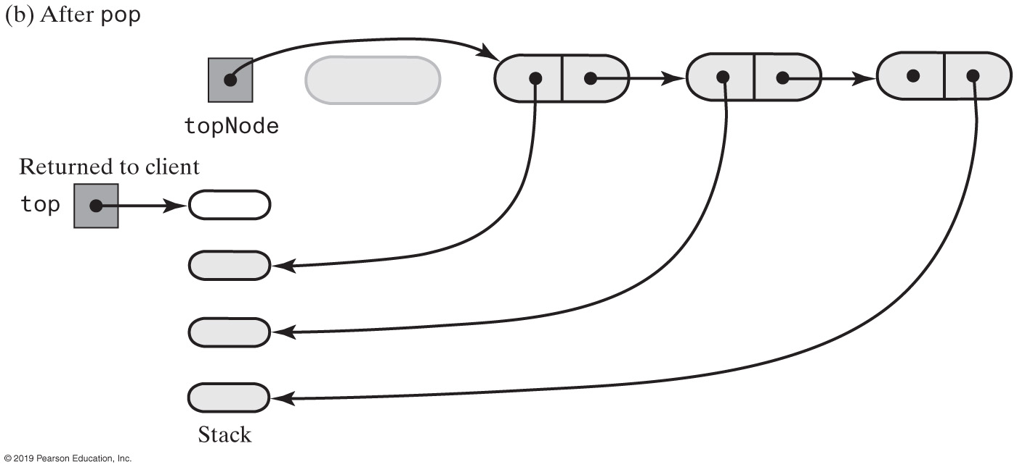
Stack | Pop
Notes:
Just like delete a node

Slide 34
Linked Implementation
public T peek()
{
if (isEmpty())
throw new EmptyStackException();
else
return topNode.getData();
} // end peek
public T pop()
{
T top = peek(); // Might throw EmptyStackException
// Assertion: topNode != null
topNode = topNode.getNextNode();
return top;
} // end pop

Slide 35
Stack | Array-Based Implementation
Each operation involves top of stack
push
pop
peek
End of the array easiest to access
Let this be top of stack
Let first entry be bottom of stack

Slide 36
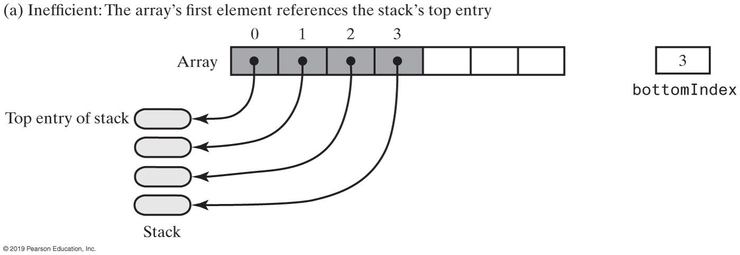
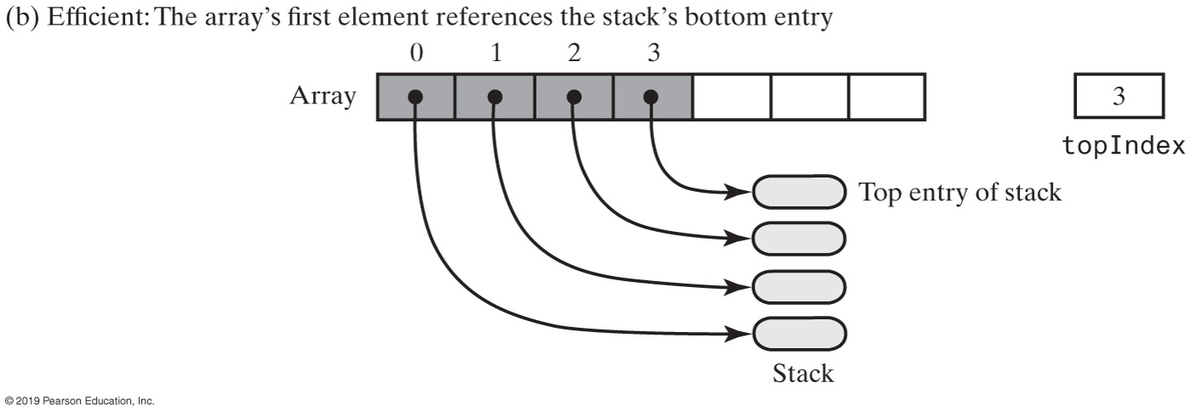
Stack | Array-Based
Array representations of a stack
Notes:
(b) is better; we have an “position” index already

Slide 37
Stack | Array-Based
/** A class of stacks whose entries are stored in an array. */
public final class ArrayStack<T> implements StackInterface<T>
{
private T[] stack; // Array of stack entries
private int topIndex; // Index of top entry
private boolean integrityOK = false;
private static final int DEFAULT_CAPACITY = 50;
private static final int MAX_CAPACITY = 10000;
public ArrayStack()
{
this(DEFAULT_CAPACITY);
} // end default constructor
public ArrayStack(int initialCapacity)
{
integrityOK = false;
checkCapacity(initialCapacity);
// The cast is safe because the new array contains null entries
@SuppressWarnings("unchecked")
T[] tempStack = (T[])new Object[initialCapacity];
stack = tempStack;
topIndex = -1;
integrityOK = true;
} // end constructor
// < Implementations of the stack operations go here. >
// . . .
} // end ArrayStack

Slide 38
Stack | Array-Based
public void push(T newEntry)
{
checkInyegrity();
ensureCapacity();
stack[topIndex + 1] = newEntry;
topIndex++;
} // end push
private void ensureCapacity()
{
if (topIndex >= stack.length - 1) // If array is full, double its size
{
int newLength = 2 * stack.length;
checkCapacity(newLength);
stack = Arrays.copyOf(stack, newLength);
} // end if
} // end ensureCapacity

Slide 39
Stack | Array-Based
public T peek()
{
checkIntegrity();
if (isEmpty())
throw new EmptyStackException();
else
return stack[topIndex];
} // end peek
public T pop()
{
checkIntegrity();
if (isEmpty())
throw new EmptyStackException();
else
{
T top = stack[topIndex];
stack[topIndex] = null;
topIndex--;
return top;
} // end if
} // end pop

Slide 40
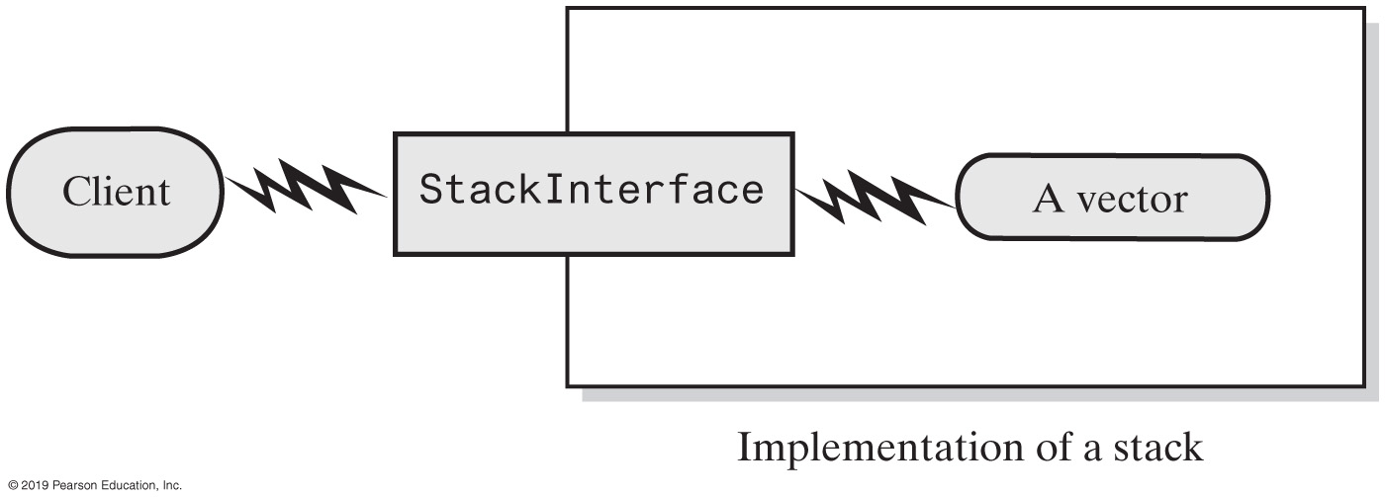
Stack | Vector-Based Implementation
A client using the methods given in StackInterface; these methods interact with a vector’s methods to perform stack operations
Notes:
A stack can be built independently to how it’s being built

Slide 41
Stack | Vector-Based
The class Vector
An object that behaves like a high-level array
Index begins with 0
Methods to access or set entries
Size will grow as needed
Has methods to add, remove, clear; also methods to determine
Last element
Is the vector empty
Number of entries
Use vector’s methods to manipulate stack
https://docs.oracle.com/javase/8/docs/api/java/util/Vector.html
https://javapapers.com/core-java/java-collection/difference-between-vector-and-arraylist-in-java/

